Slide 1
Data, Models and Policy

Slide 2
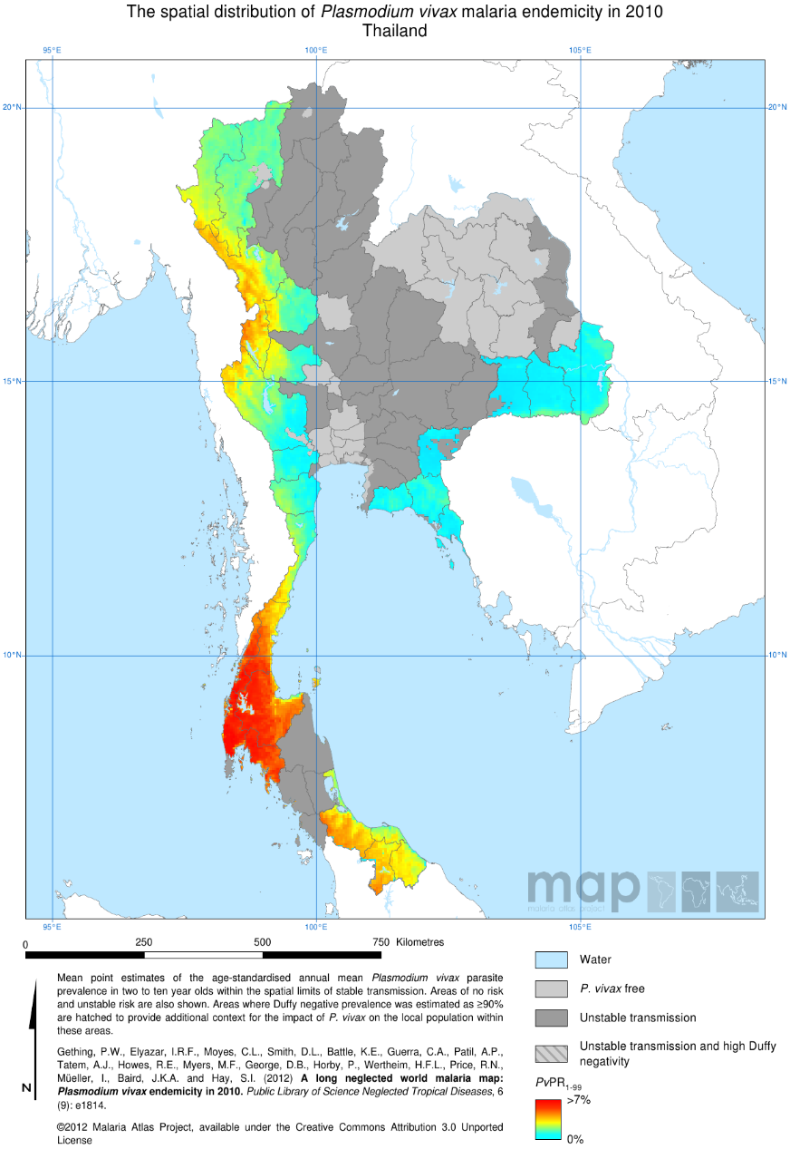
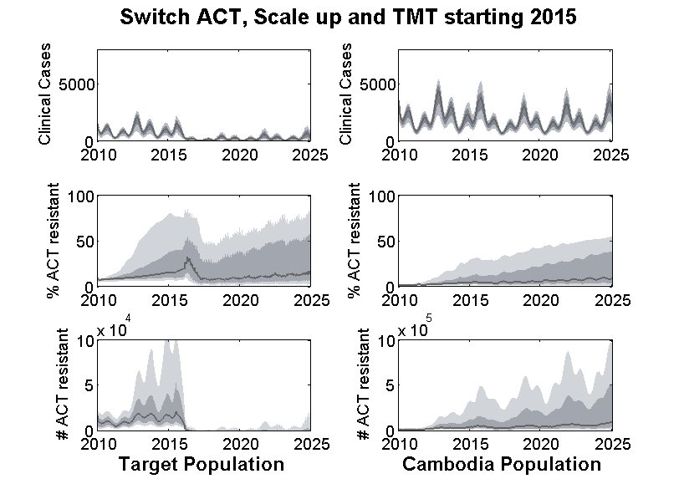
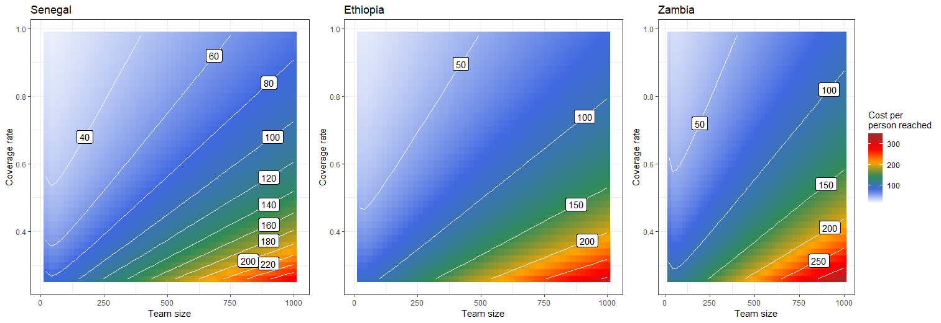
Represent the local epidemiology
Reproduce long term trends
Project future trends
Predict cost of intervention packages
Inform optimal intervention policy
Appropriate data
Appropriate spatial/life history of infection model structure
Appropriate vector bionomics
Historic data on interventions
Adequate model fitting procedures
Model can incorporate intervention data at different temporal/spatial scales
Model flexibility in incorporating new/adjusted combinations of interventions
Model needs to include detailed intervention logistics
Cost data and associated cost functions
Direct link between intervention logistics in the cost functions and the simulated logistics in the model
Update as new data is made available

Slide 3
Representing the local epidemiology
Question Data Model Structure Analytical Methods Answer

Slide 4
Factors Influencing Disease Transmission
Host
Age
Pathogen
Infectivity
Environment
Weather
Pathogenicity
Virulence
Immunogenicity
Antigenic stability
Survival
Gender
Genotype
Behaviour
Nutritional status
Health status
Housing
Geography
Occupational setting
Air quality
Mosquito density
Genotype

Slide 5
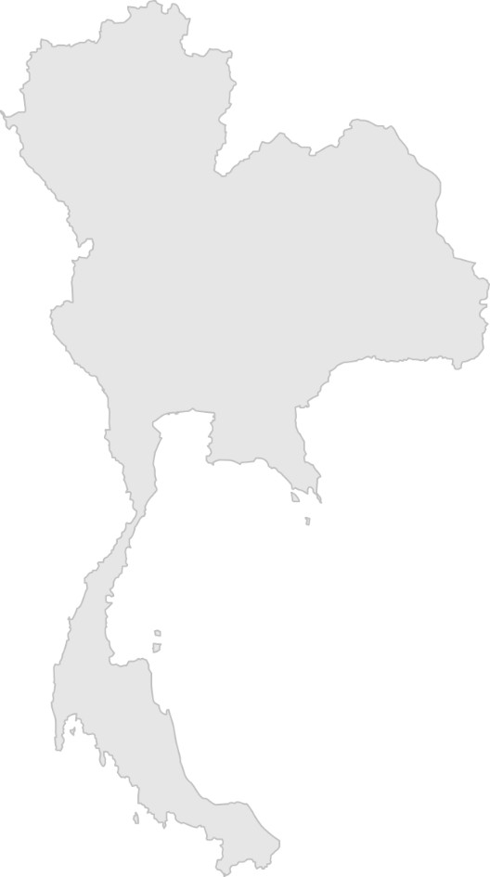
Importance of spatially detailed information

Slide 6
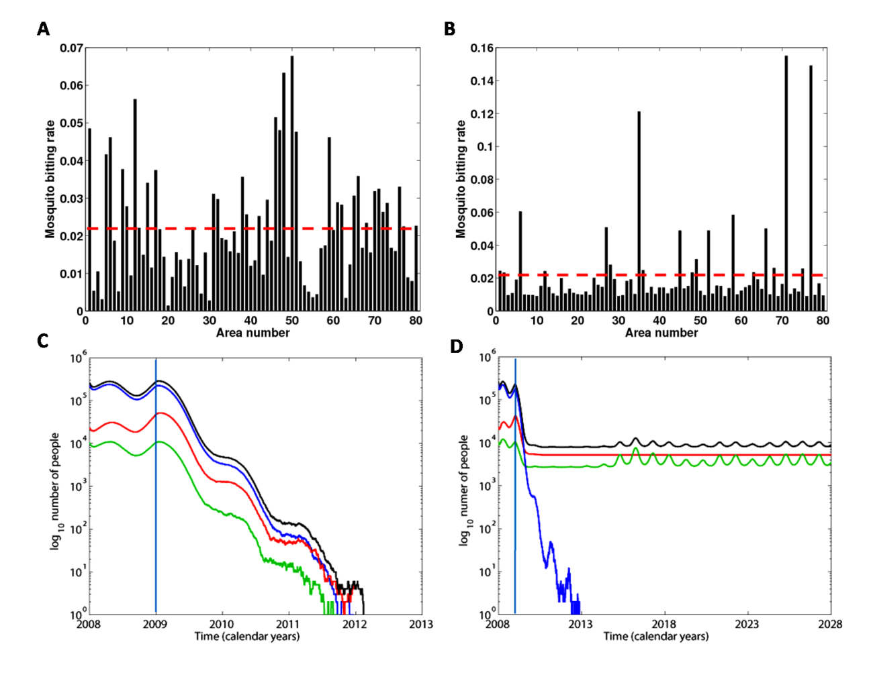
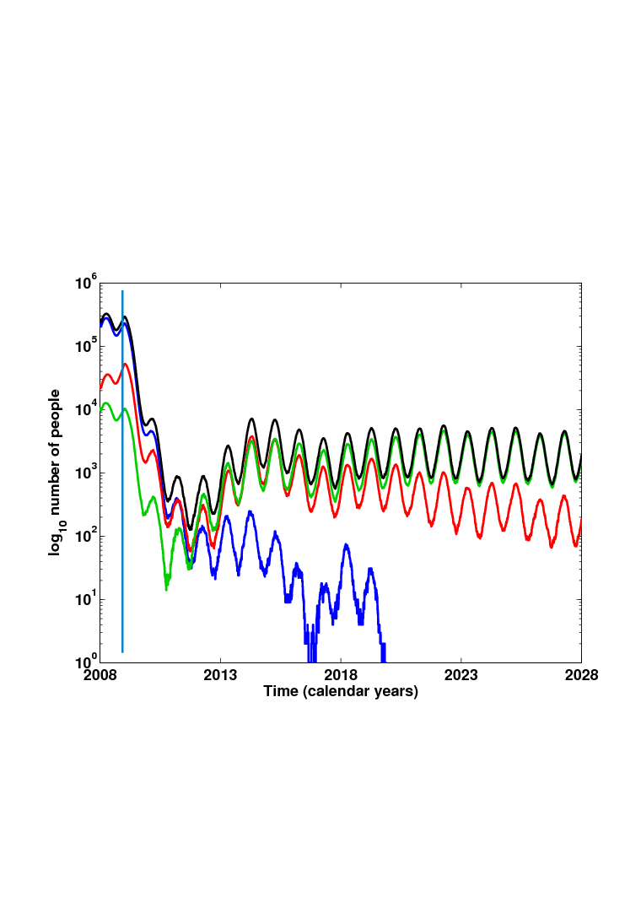

Slide 7
What is then the appropriate dataset?
It is ultimately determined by the question.
Data spatial resolution cannot be lower than the level of implementation implied in the question
Lets look at a few examples:
Business case for malaria elimination in the Asia-Pacific
Tackling high treatment failure rates in certain Cambodia ODs
VMW network scale-up
Interventions addressing forest Malaria

Slide 8
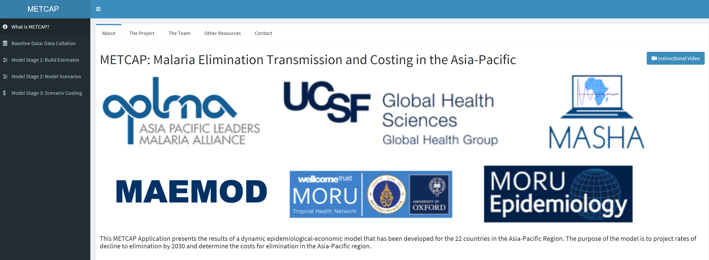
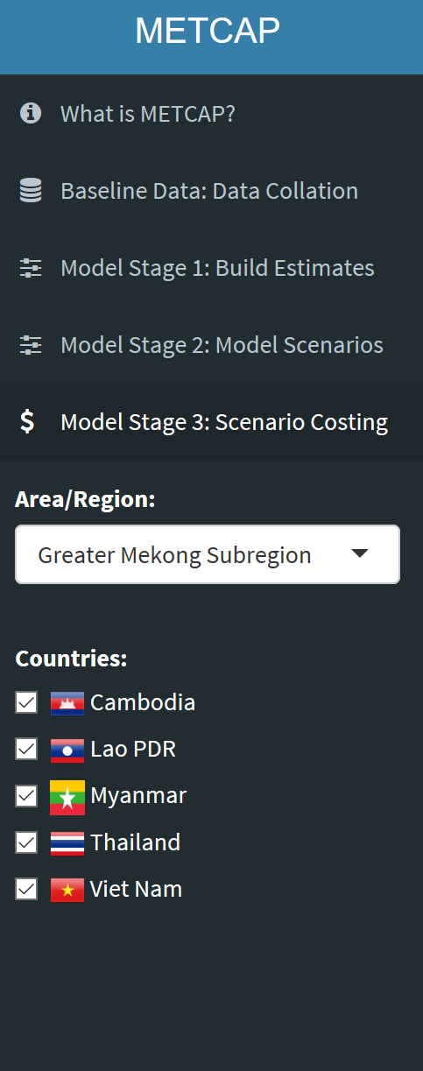
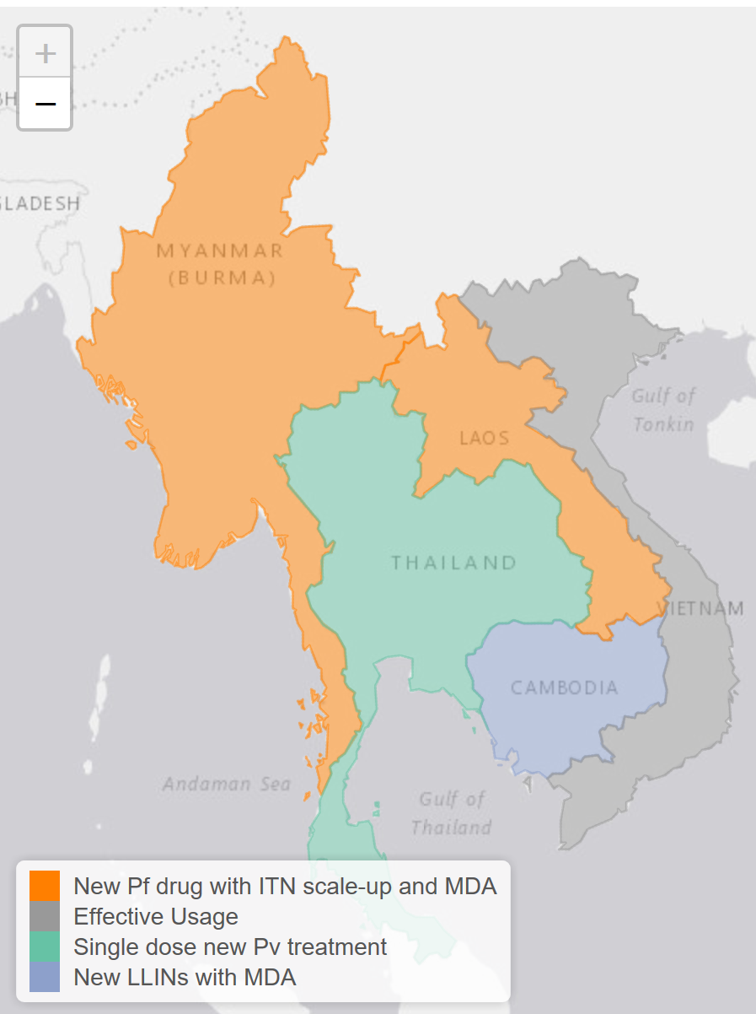
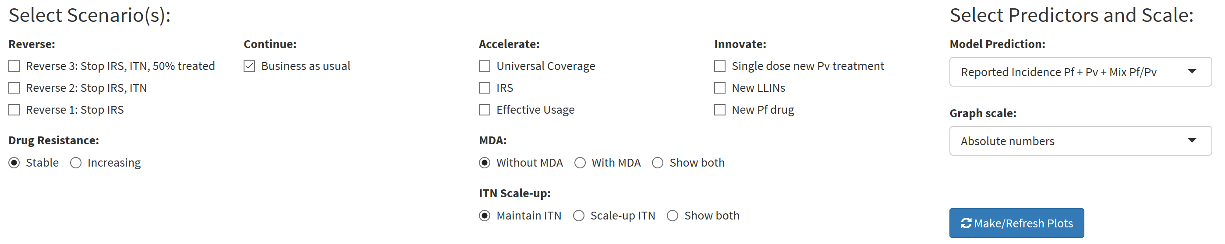
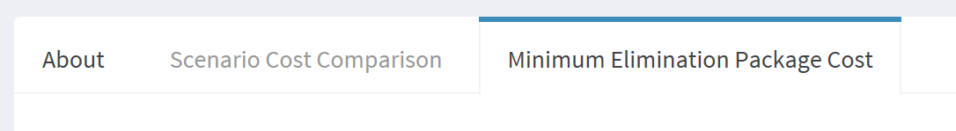
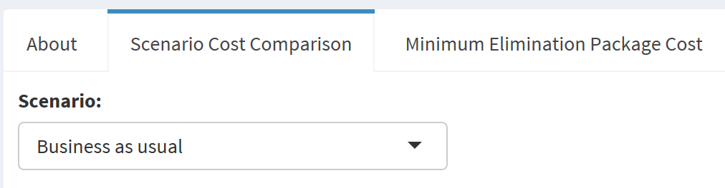
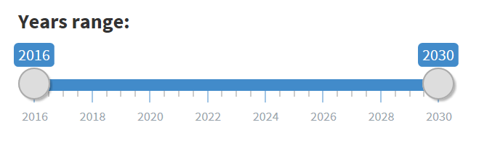
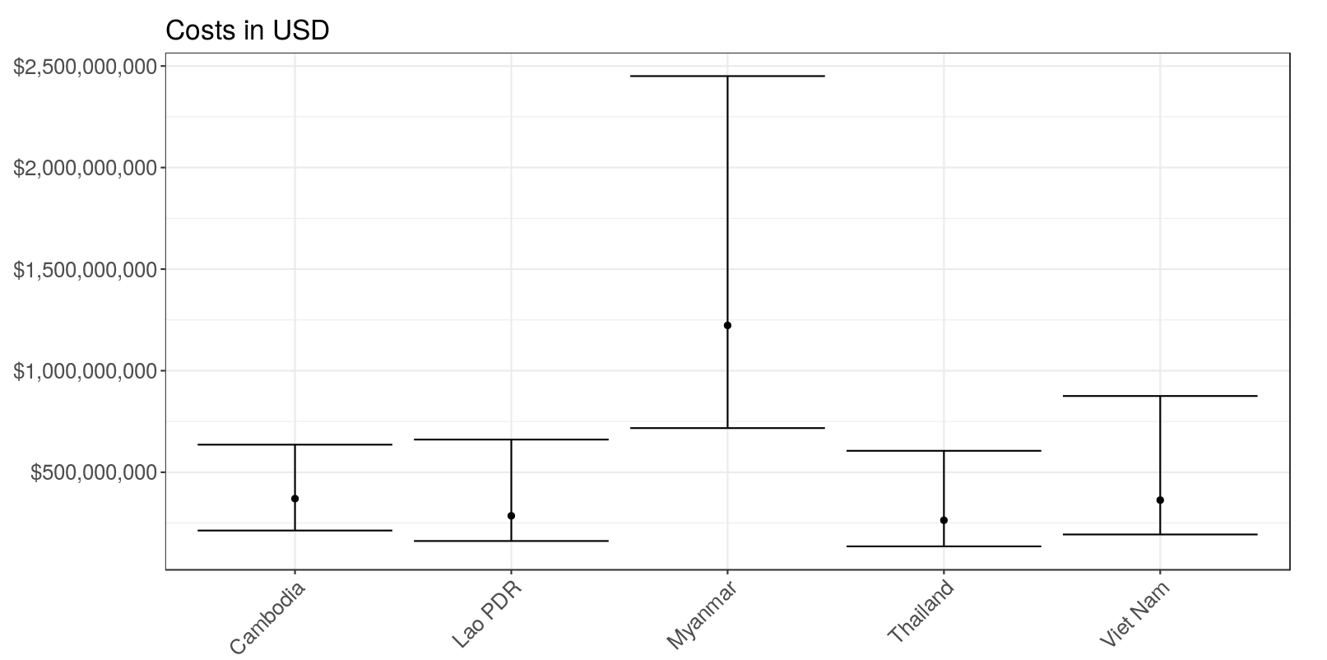
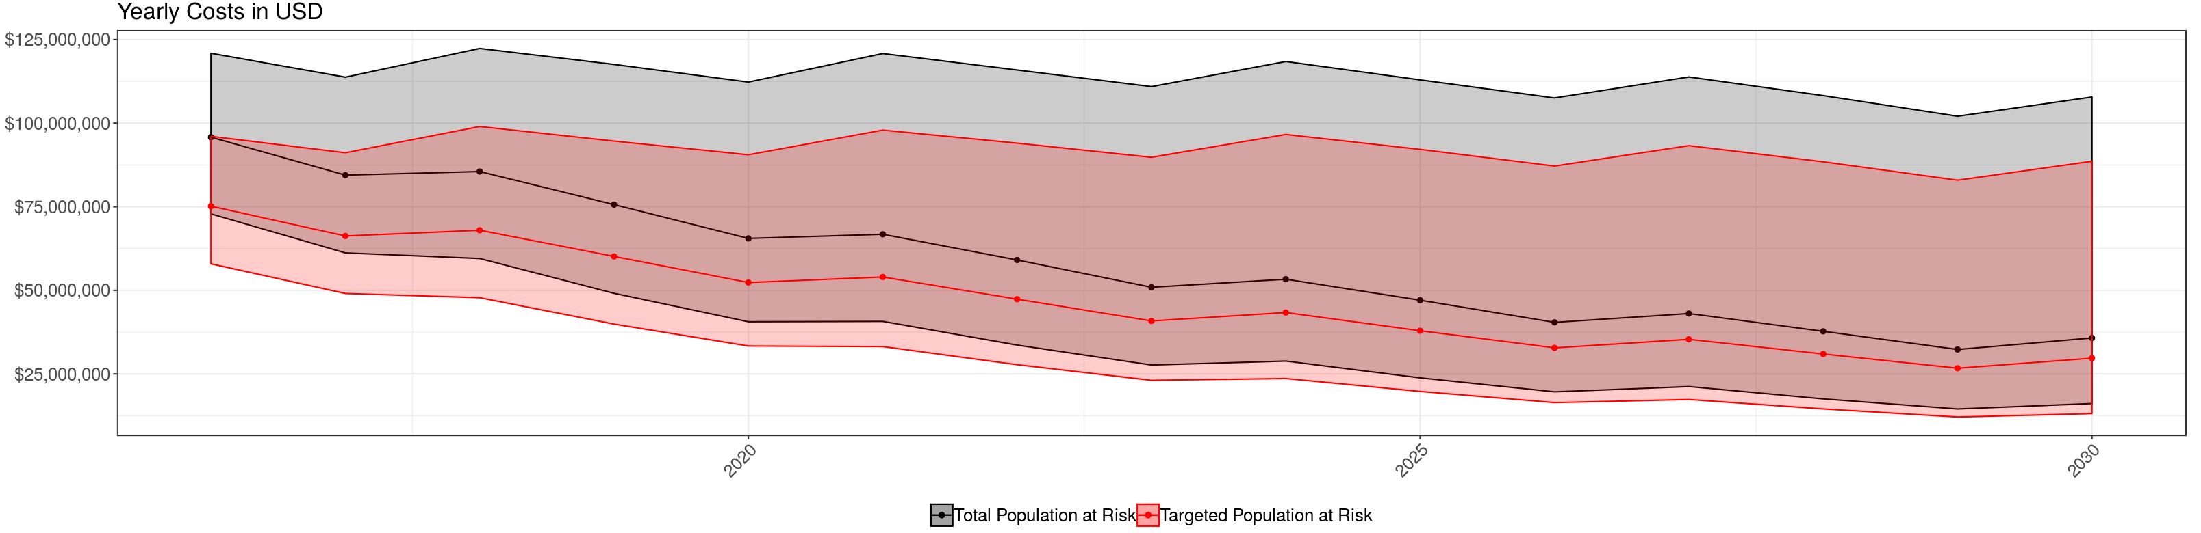
www.metcapmodel.net/

Slide 9
How much will it cost to reach elimination in the Asia-Pacific by scaling up currently available tools?
Ideal Data
Admin level 2 epidemiological data (weekly) for each country with accompanying historic intervention data
Available Data
Country level epidemiological data (monthly) for each country with accompanying historic intervention data

Slide 10
Can we delay the inevitable rise in clinical cases and mortality (and the numbers of ACT resistant infections ) in a target area (high treatment failure rates)?
Ideal Data
Weekly Epidemiological Data for all Operational Districts with accompanying historic intervention and genetic data
Available Data
Monthly Epidemiological Data for 77 Operational District with accompanying historic intervention data
Reducing # resistant during TMT
“last man standing”
Spread of resistance outside target area

Slide 11
What is the impact of the VMW network on malaria case incidence and prevalence?
Available Data = Ideal Data
Weekly incidence data per VMW over a long period of time.
Model fit to data
Predict VMW closure in the future

Slide 12
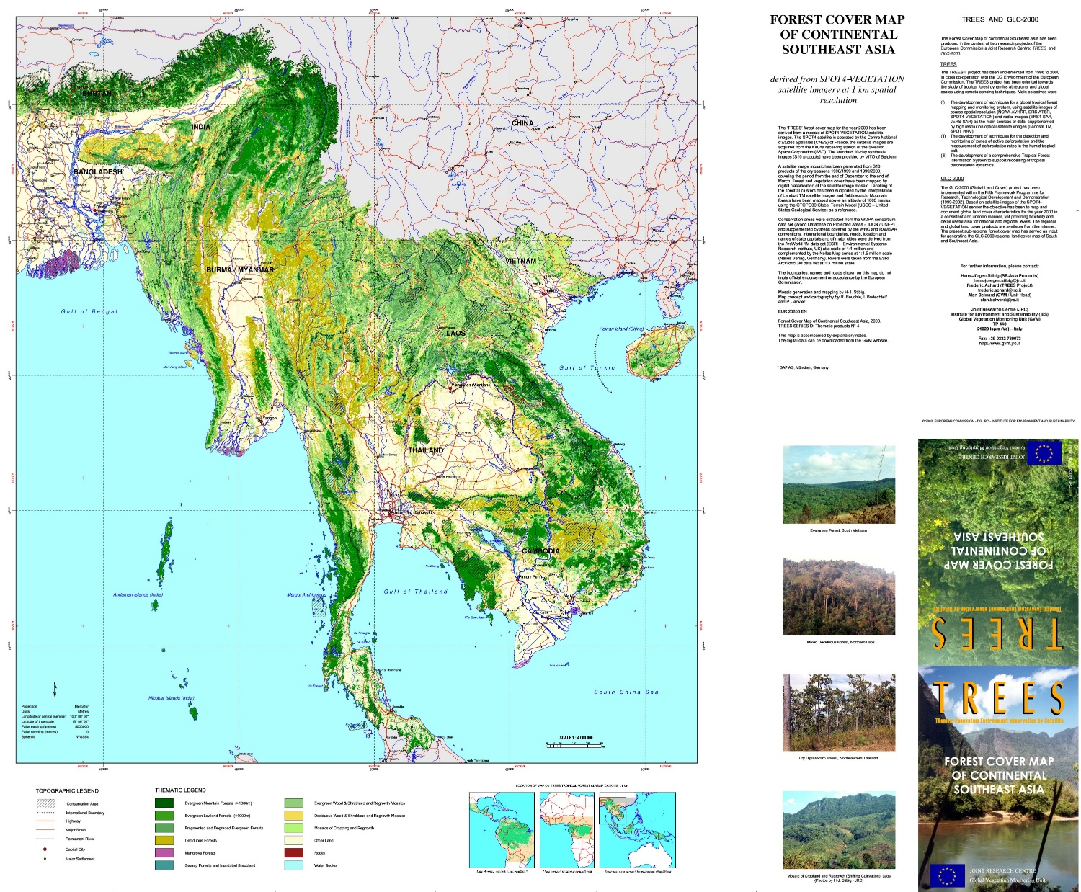
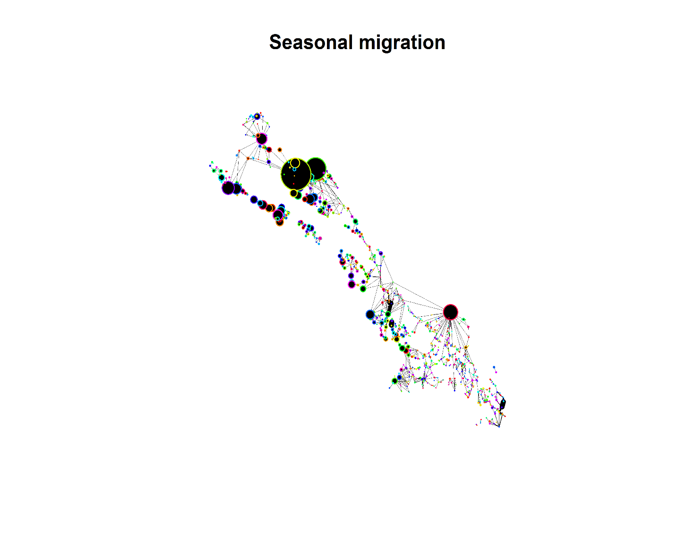
What is the best intervention strategy in forest malaria settings?
How to Identify regions of interest?
Foci of transmission
How to Identify populations at risk?
Age and sex ratios
Forests and plantations
Occupation
What are the patters of disease transmission?
How does human behaviour change the vector/human interface?
What interventions could be most impactful?
TPP vector interventions, spatial repellents e.g.
Travel bans as an intervention

Slide 13
Human Mobility
How do people move between villages?
How frequently do people go to the forest/plantation?
How long do people spend in the forest?
How long do they spend in the plantations?
Where do people sleep when not in their home village?
Do they sleep in huts in the plantation?
Are there “villages” inside plantations/forests?
What prevention measures do they use in the forest/plantation?
?
Forest
?
?
Plantation

Slide 14
How can modelling be useful?
How can we interrupt transmission in a forest setting?
Is malaria transmission sustained in the villages or plantations?
Evaluate persistence when there is no connection with the forest
Predict intervention outcomes
Identify the drivers of malaria transmisison
Forest

Slide 15
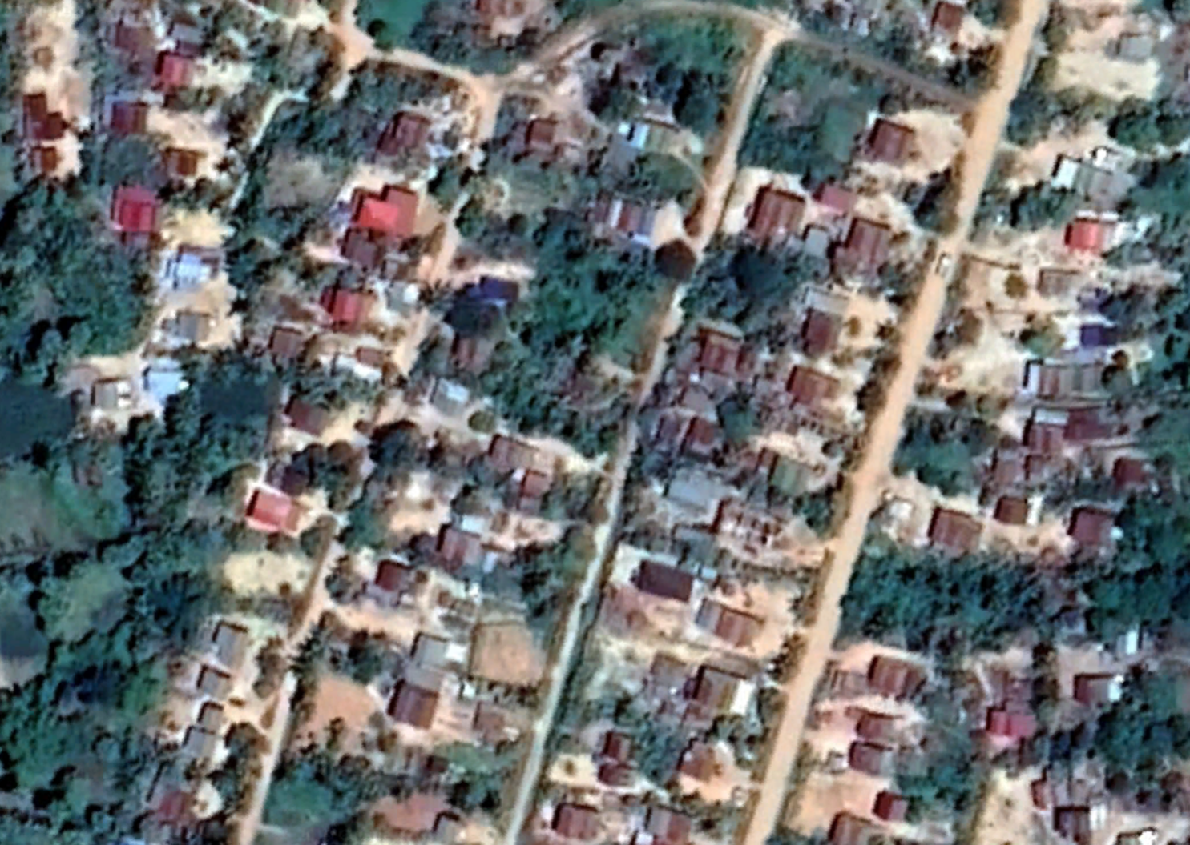
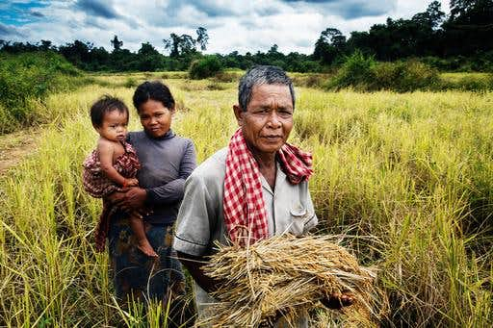
How do we optimize individual protection?
What is the level of universal coverage required for elimination?
What are the best reactive/active strategies in low API villages?
Should we have VMWs in all villages?
What intervention coverage should we have in each Province?

Slide 16
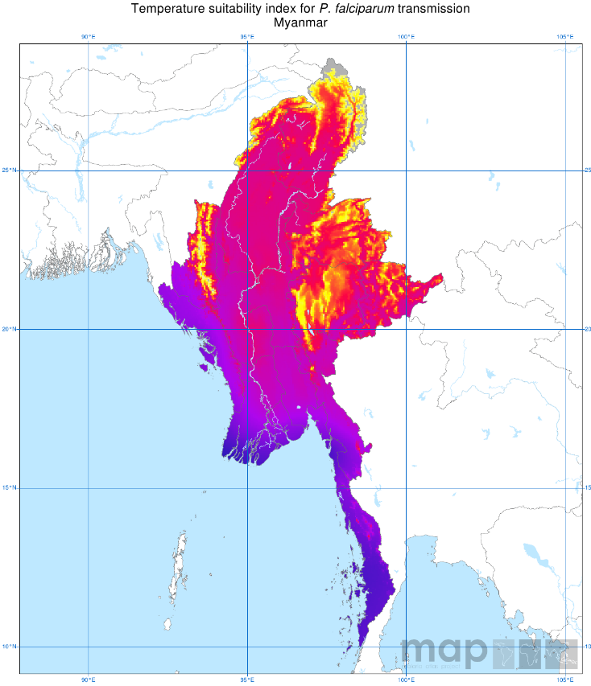
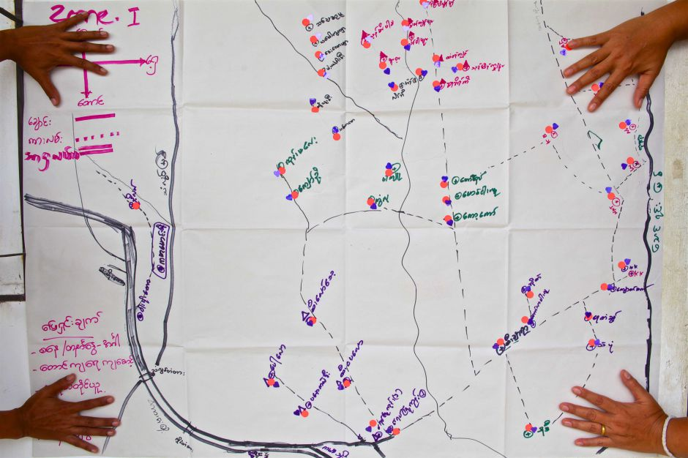
Population Structure/ Mobility
Putting all key elements together
Geographical differences
Logistics

Slide 17
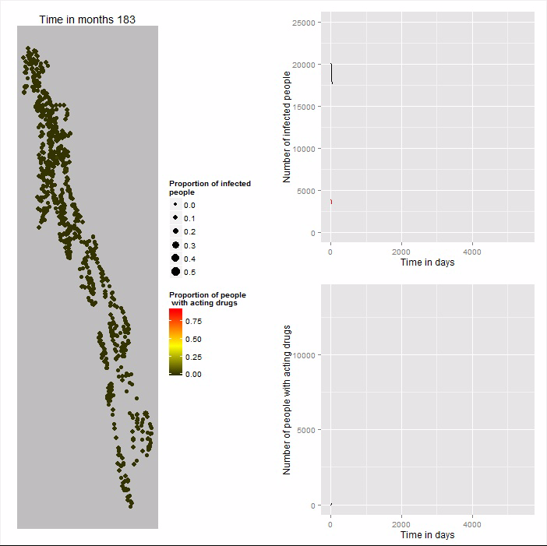

Slide 18


Intervention Logistics
Cost effectiveness
$ per case averted
$ per percent reduction in prevalence
Intervention Costs

Slide 19
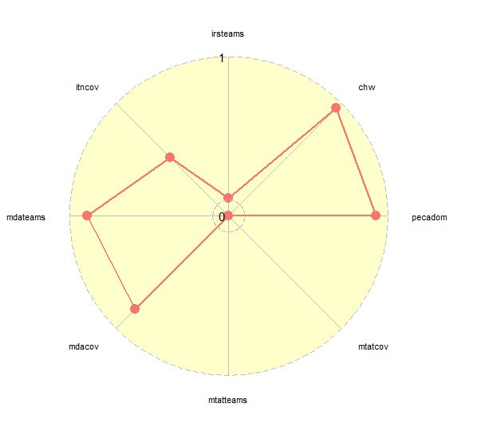
Input | Value | Cost (in millions)
IRS teams | 57 | 12.09
VMW coverage | 0.96 | 27.19
PECADOM | 0.93 | 9.02
MTAT coverage | 0 | 0
MTAT teams | 0
MDA coverage | 0.83 | 11.65
MDA teams | 444
ITNs | 0.52 | 5.25
Predicted Impact | 95.52
Total cost (in millions) | 65.33
vmw

Slide 20
Budget (in millions) | 50 | 40 | 30 | 20 | 10
IRS teams | 56 | 0 | 0 | 32 | 67
VMW coverage | 0.98 | 0.98 | 0.98 | 0 | 0
PECADOM | 0.67 | 0.54 | 0 | 0.13 | 0
MTAT coverage | 0 | 0 | 0 | 0 | 0
MTAT teams | 0 | 0 | 0 | 0 | 0
MDA coverage | 0.63 | 0.13 | 0 | 0.38 | 0
MDA teams | 104 | 52 | 0 | 153 | 0
ITNs | 0 | 0.081 | 0 | 0 | 0
Predicted Impact | 94.3 | 71.4 | 59.4 | 56.9 | 46.6
Total cost (in millions) | 49.6 | 38.4 | 29.2 | 18.6 | 9.8

